Slide 1
Climate Study for the United States
Team 10
Member: Fan Wang, Pengkun Li, Aman Goyal
GitHub: https://github.com/WFighter909/ECE-143-Group-10
Notes:
Good Evening everybody,
Fan, Pengkun and I are going to present our project entitled Climate Study for the United States.

Slide 2
CONTENTS
Introduction
Data Collection and Preprocessing
Comparison between West and East Coast
Data Visualization of San Diego
Evaluations and Applications

Slide 3
Introduction
/01

Slide 4
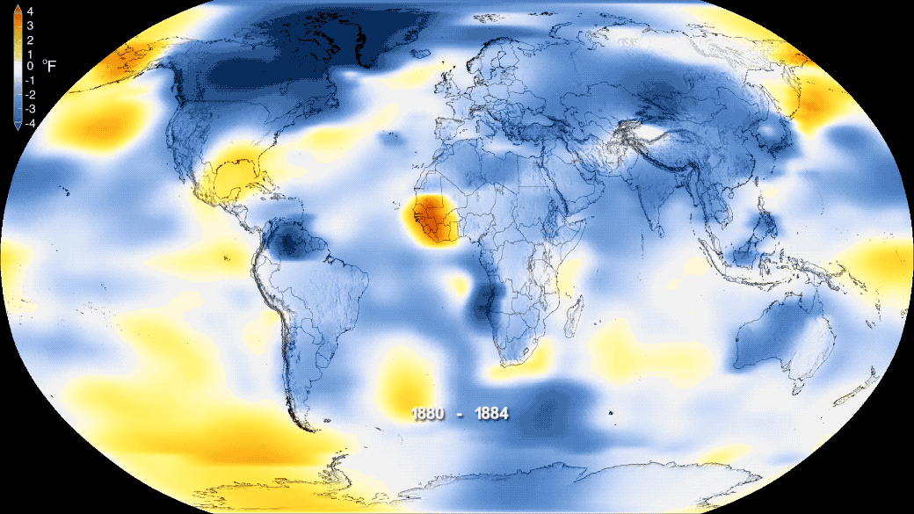
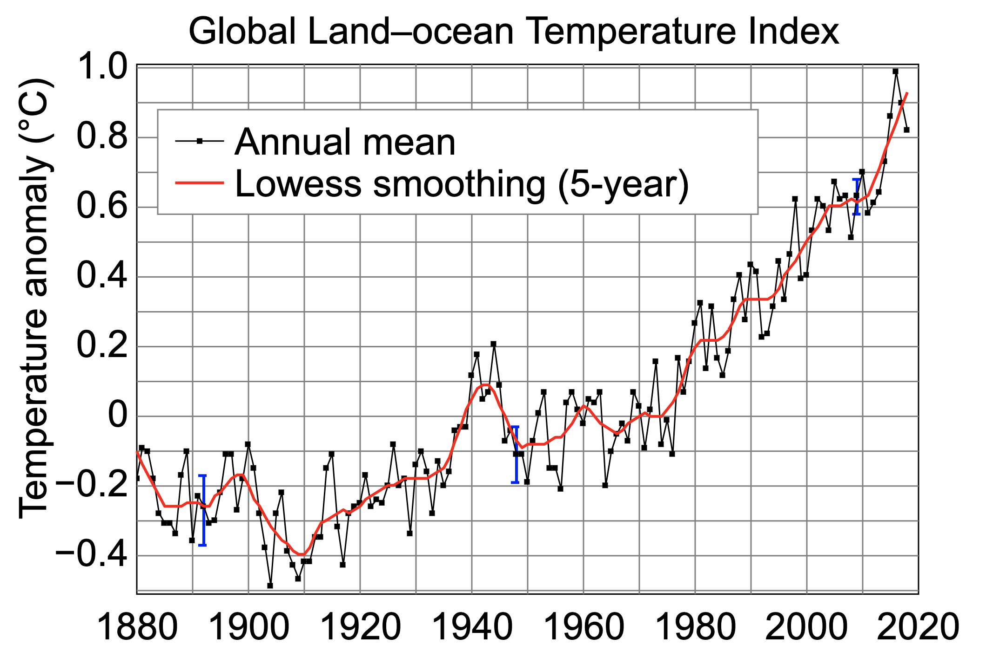
Climate Change in Recent Years
The Phenomenon of Climate Change:
global warming
forest degradation
desertification
https://climate.nasa.gov/news/2876/new-studies-increase-confidence-in-nasas-measure-of-earths-temperature/
Notes:
Climate change, as we all know, is a long-term phenomenon. Global warming is one of the aspects of climate change. Due to increase in the emissions of green-house gasses, the average temperature of our planet is on the rise.

Slide 5
Proposals & Goals
To explore the trends of climate change in some cities in the United States by visualizing weather data over the past few decades.
To study the relationship between the geographical position and climatic correlation.
Notes:
Through this project, we aim to explore the trends of climatic conditions in the US.
We have selected 7 coastal cities. We do a correlation study for the average temperatures and precipitation before taking a deep dive into San-Diego’s weather study.

Slide 6
Data Collection and Preprocess
/02

Slide 7
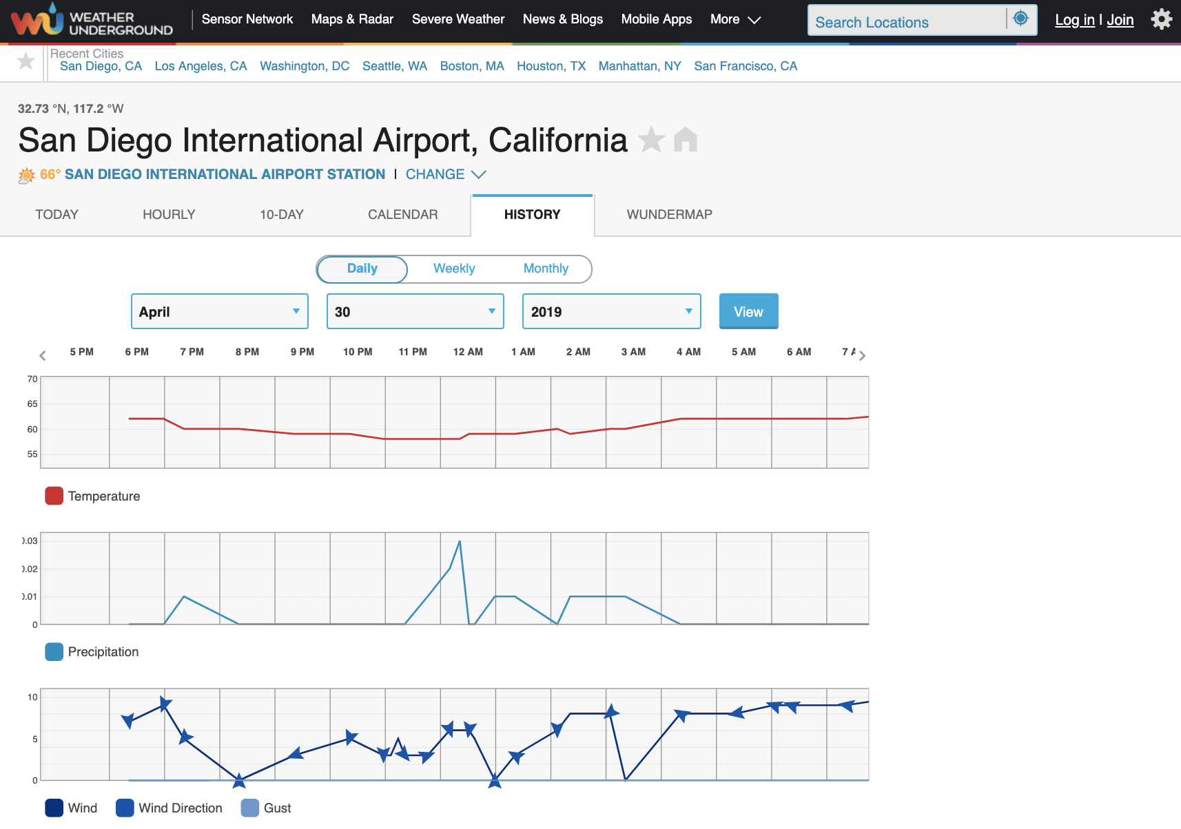
Weather Underground
link
A sensor network for weather information
Notes:
link
We formed our own dataset by scraping data from the weather underground website. This website collects weather data for a particular place by combining the readings of various sensors deployed as a part of the sensor network across the place.

Slide 8
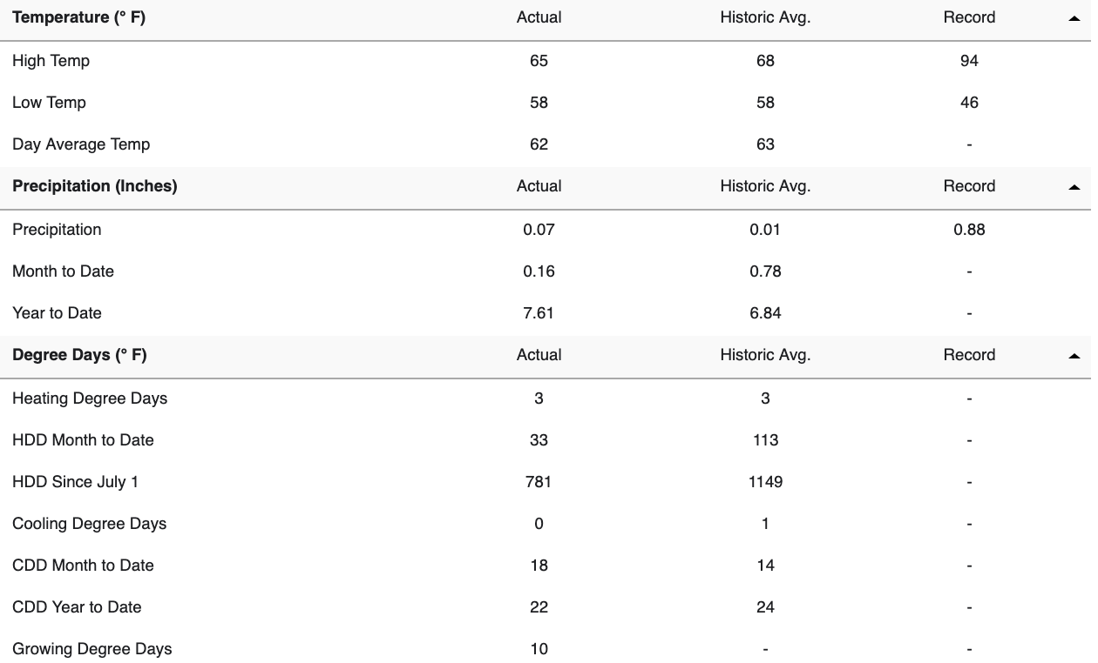
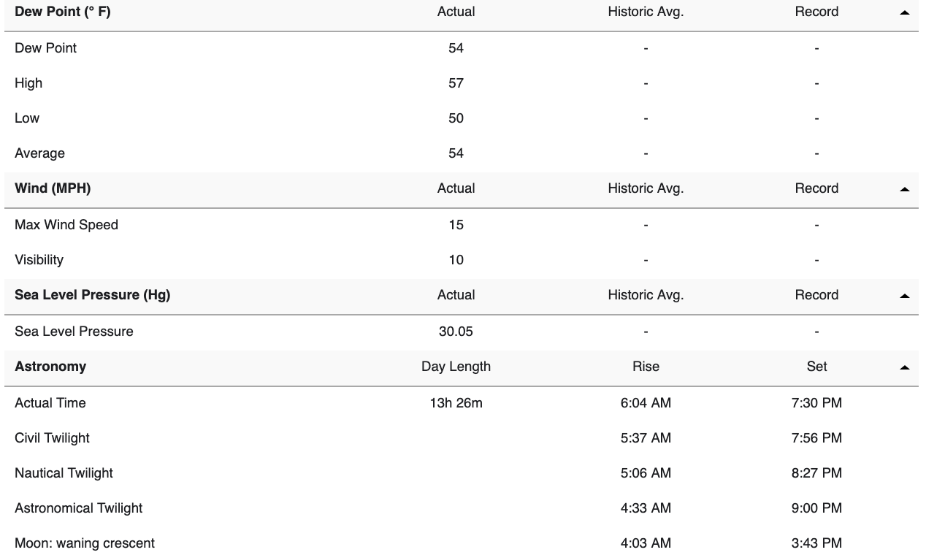
Data Summary
Notes:
The website provides a ton load of data! However, for our project, we worked on a few relevant columns such as the day-average temperature, precipitation and weather condition. One of the reasons for selecting these columns was that the data in these columns was more consistent than others.

Slide 9
Data Selected
weather icon

Slide 10
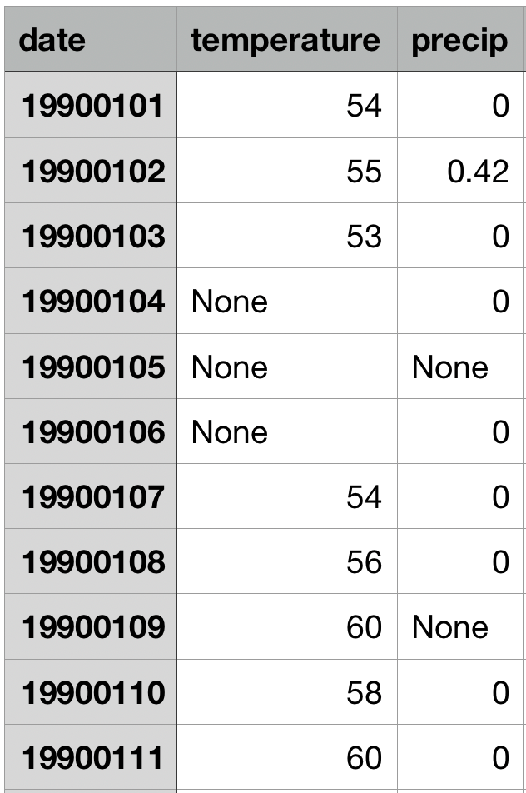
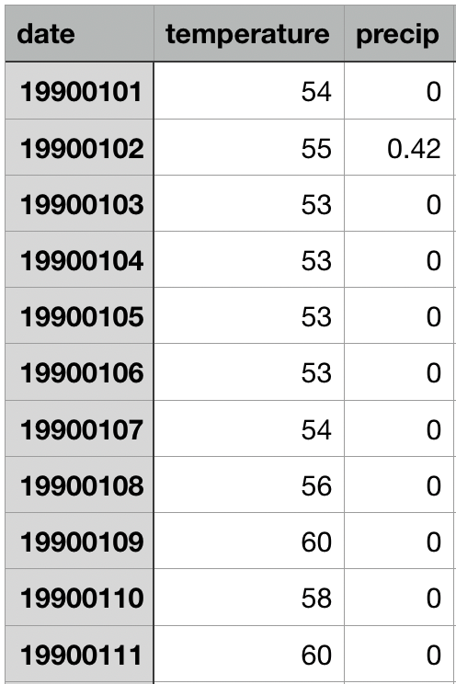
Data Cleaning and Missing Data Filling
missing_values = ["n/a", "na", "--", None, 'None']
use forward-fill to fill the missing values:
pandas.DataFrame.fillna(method="ffill", inplace=True)
Notes:
for some cells where the data was not available, we used the forward fill method from pandas to compensate for the missing data

Slide 11
Comparison between West and East Coast
/03

Slide 12
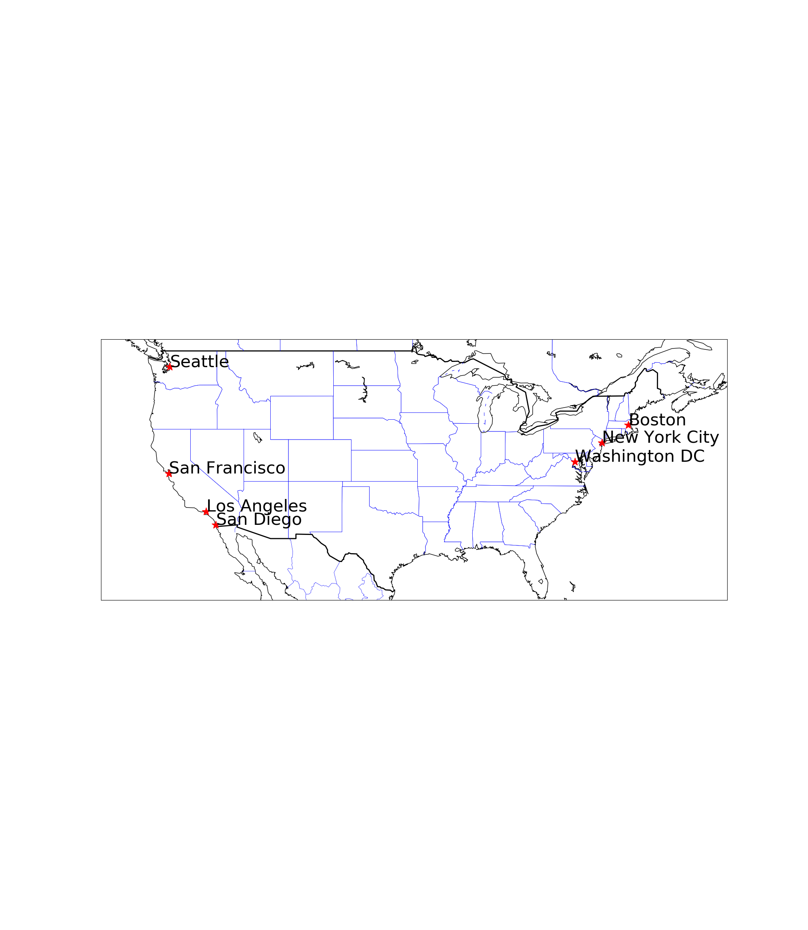
The Distribution of Selected Cities
city code reference

Slide 13
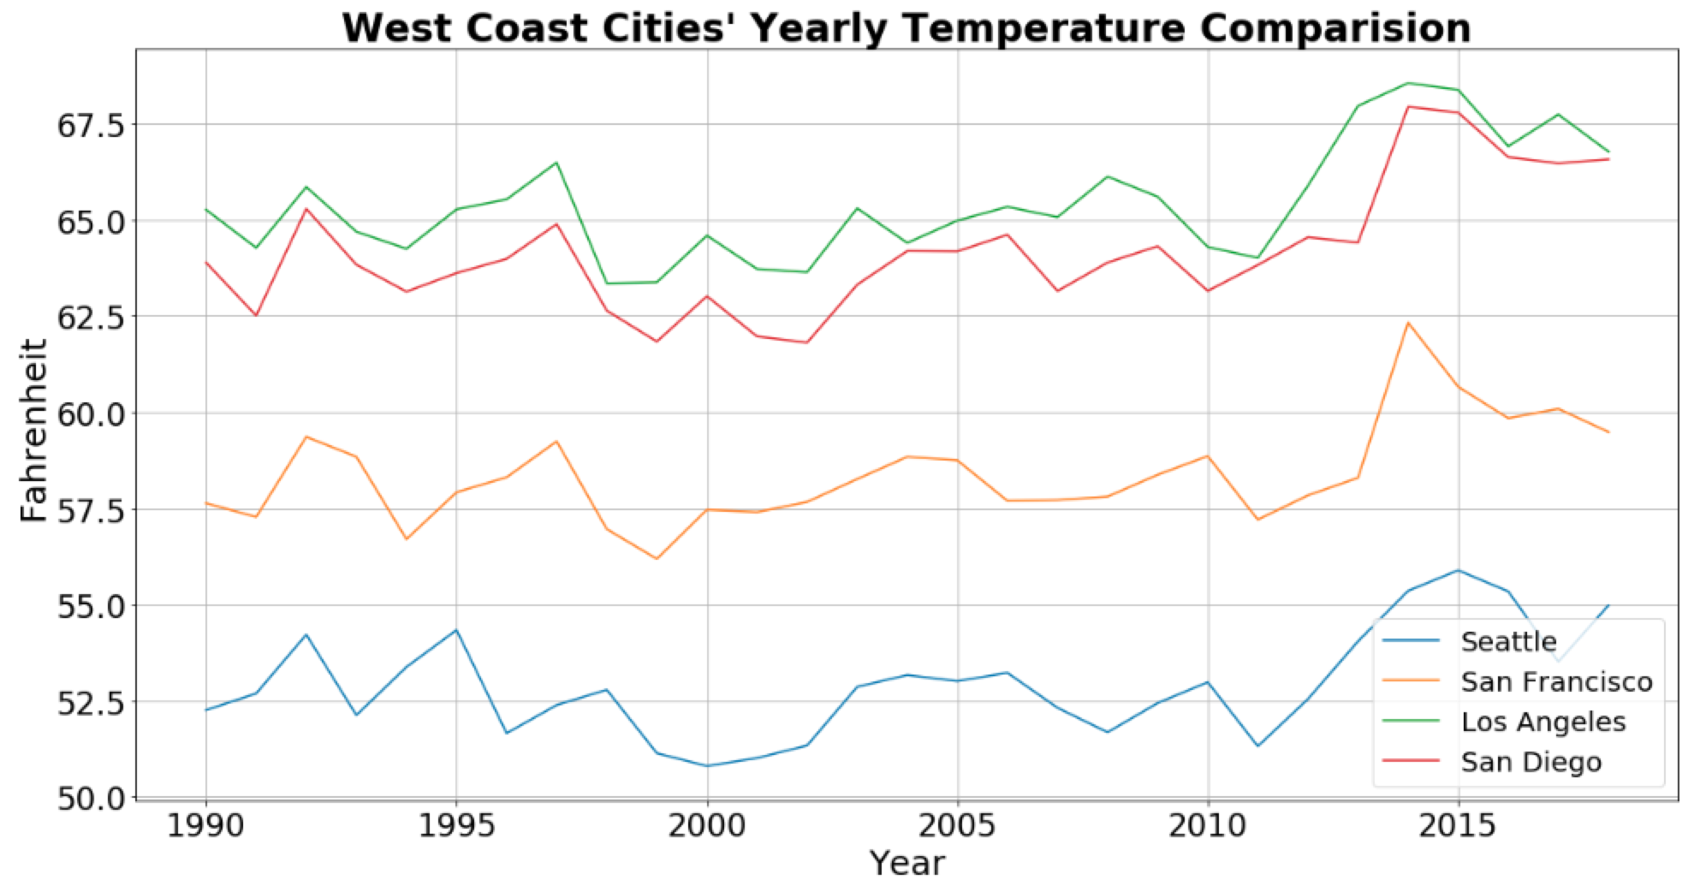
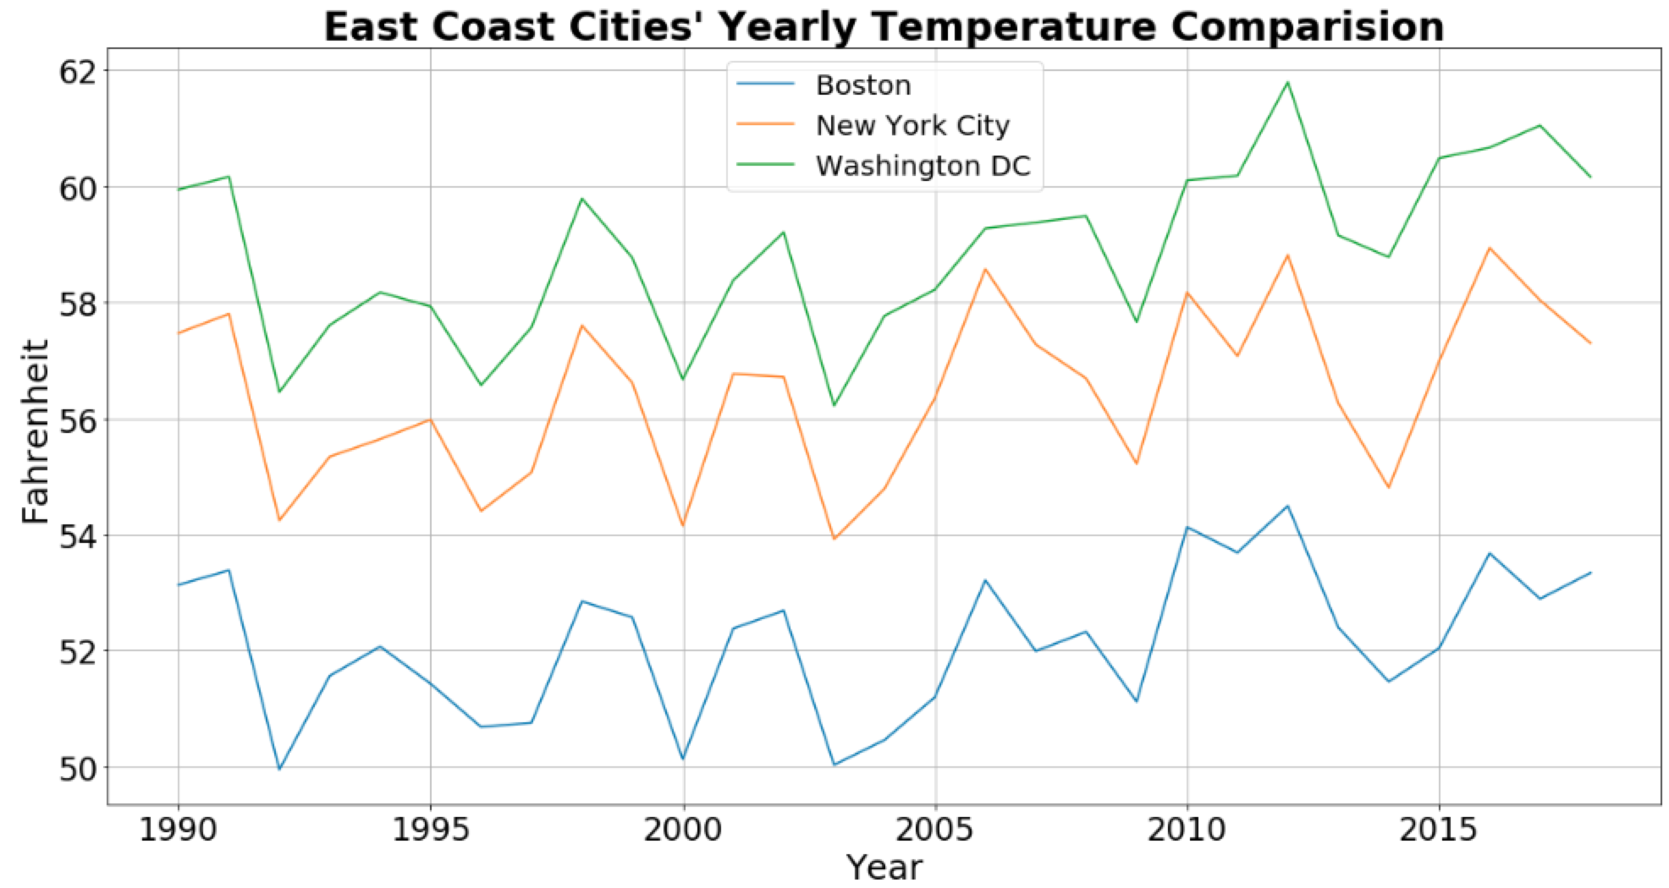
Average Temperature Comparison -- Year wise
Notes:
As we move from South to North (top to bottom in the graph), we see an expected decrease in temperature.
Also, we can observe a correlated weather transition over the years for the cities which grouped by east or west coast.
Cities in the same latitude on the east and west coasts (i.e. Boston and Seattle) have roughly the same range of temperature fluctuations.
Temperatures in all cities show an overall slightly upward trend.
Average temperature for the cities appears to be correlated, as shown in the next figure:

Slide 14
Average Temperature Correlation
Notes:
The difference of the east coast city precipitation between the north and south latitude is small
The east coast has more precipitation than the west coast, and in 1995 there was a collective peak.

Slide 15
Summary
The average temperature of the cities shows good correlation w.r.t their longitude.
As we move North, the average temperature decreases
Temperatures in all cities show an overall slightly upward trend.

Slide 16
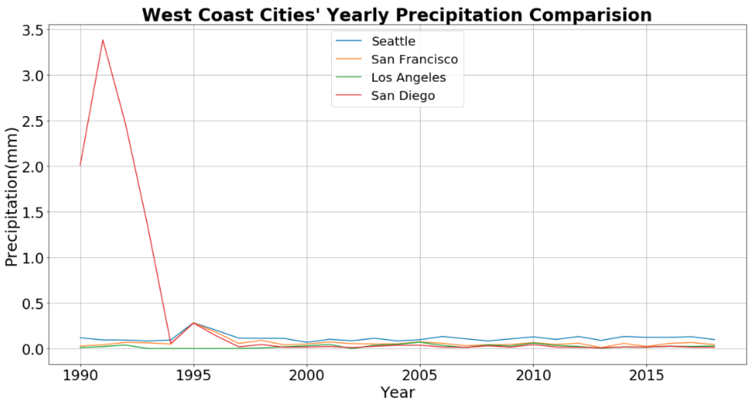
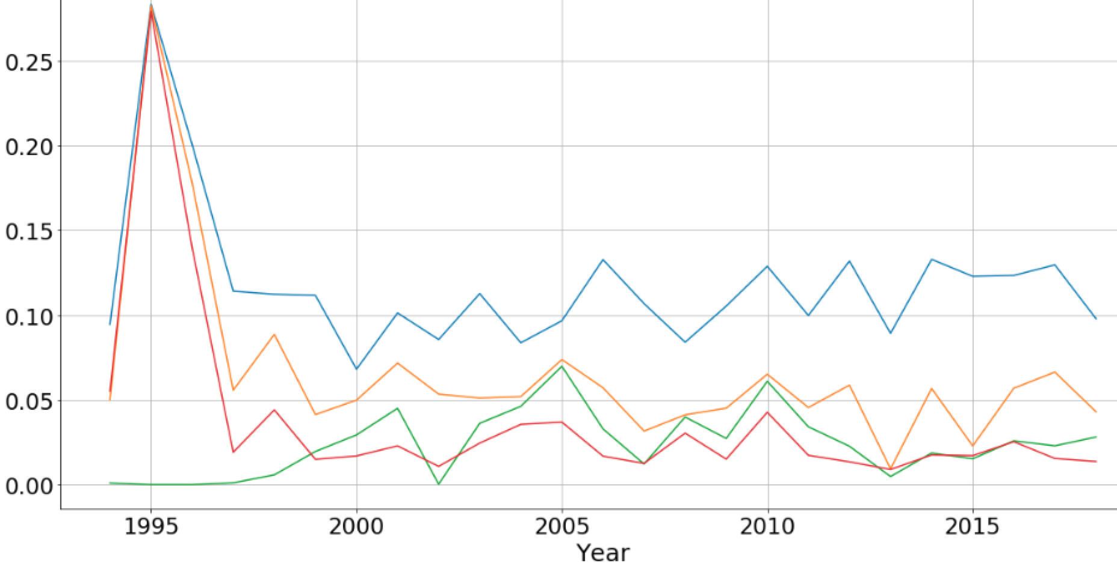
Average Precipitation Comparison -- Year wise (West Coast)
Notes:
The difference of the wast coast city precipitation between the north and south latitude is small
Urban precipitation on the West Coast is relatively small and stable, except for San Diego’s data in 1991. This cause us to inspect SD in detail

Slide 17
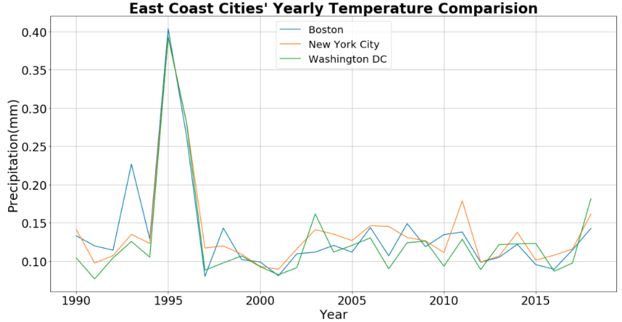
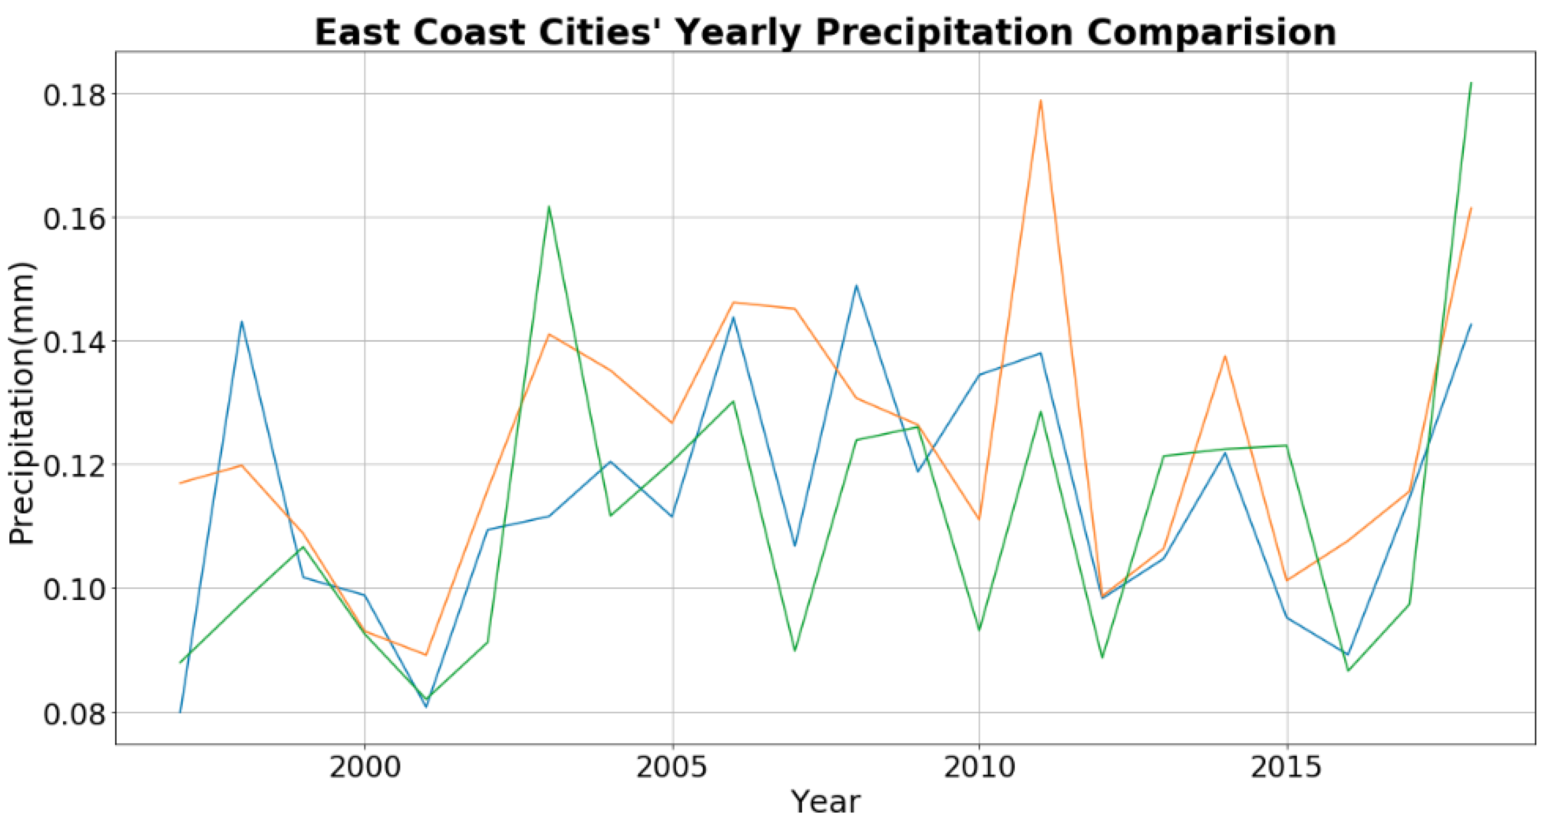
Average Precipitation Comparison -- Year wise (East Coast)
Notes:
The difference of the east coast city precipitation between the north and south latitude is small
The east coast has more precipitation than the west coast, and in 1995 there was a collective peak.

Slide 18
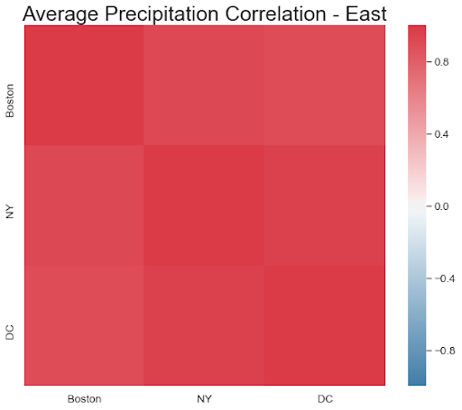
Average Precipitation Correlation
Notes:
The precipitation correlation graph gave us contrasting results as compared to the temperature correlation plots. It may be because of the difference in the cities’ precipitation conditions due to coastal weather.
The difference of the east coast city precipitation between the north and south latitude is small
The east coast has more precipitation than the west coast, and in 1995 there was a collective peak.

Slide 19
Summary
Urban precipitation on the West Coast is relatively small and stable, except for San Diego’s data in 1991.
East coastal cities have more precipitation than west coastal cities. But latitude changes have little effect on changes in precipitation.

Slide 20
Data Visualization for San Diego
/04

Slide 21
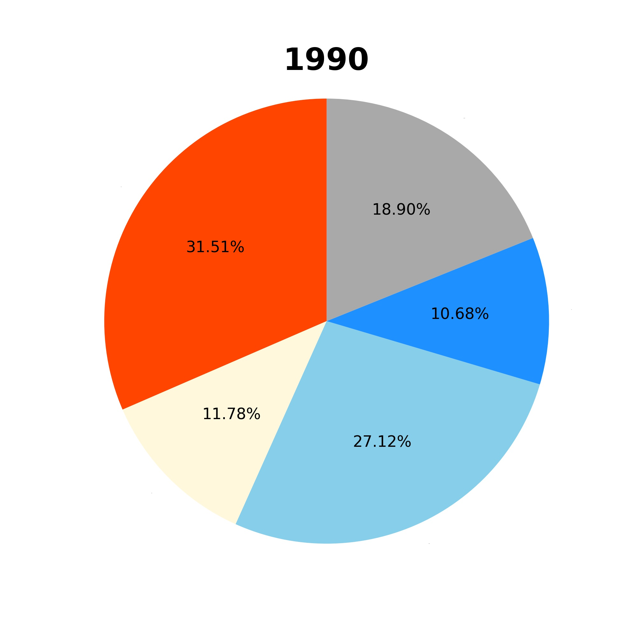
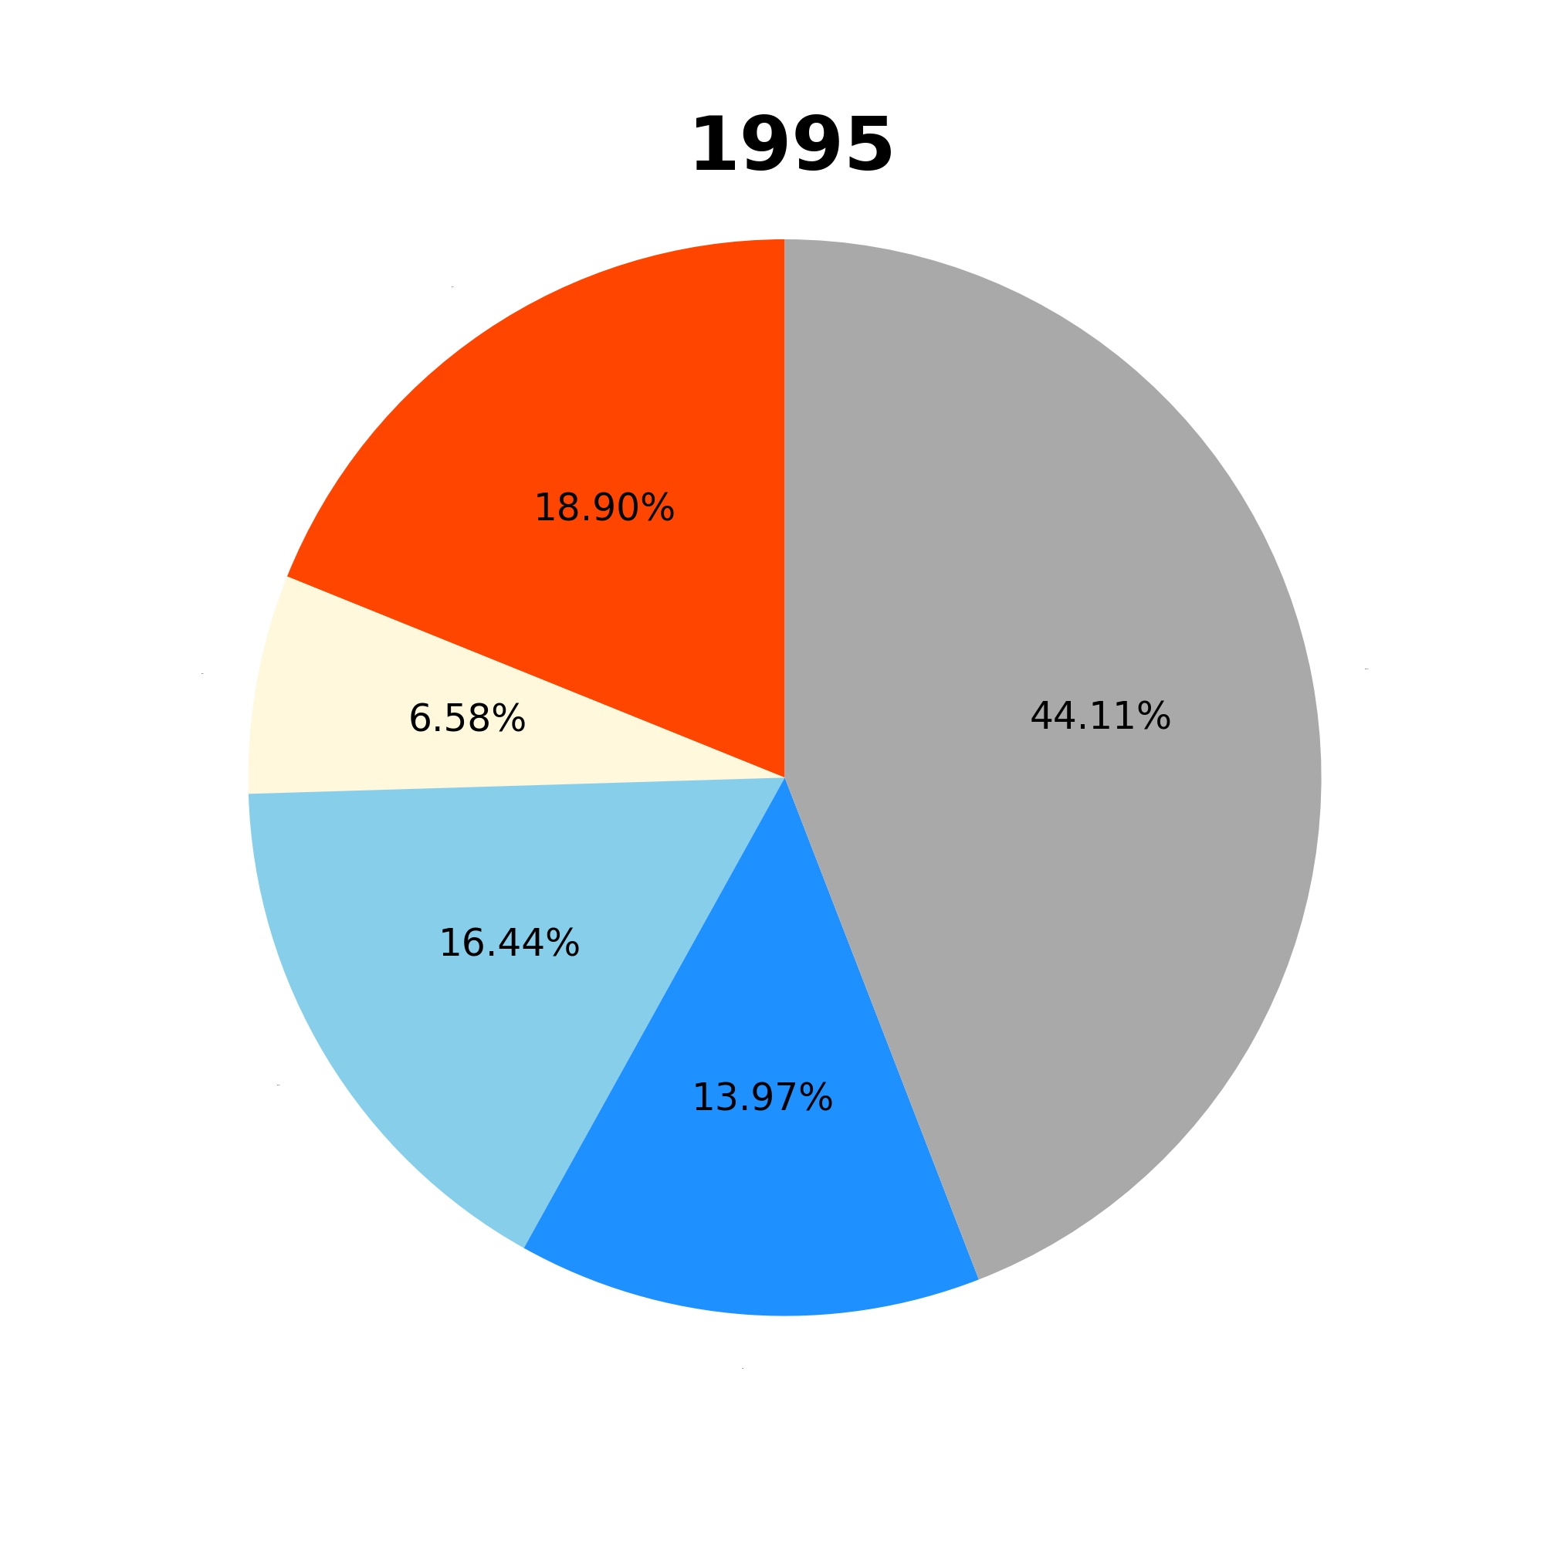
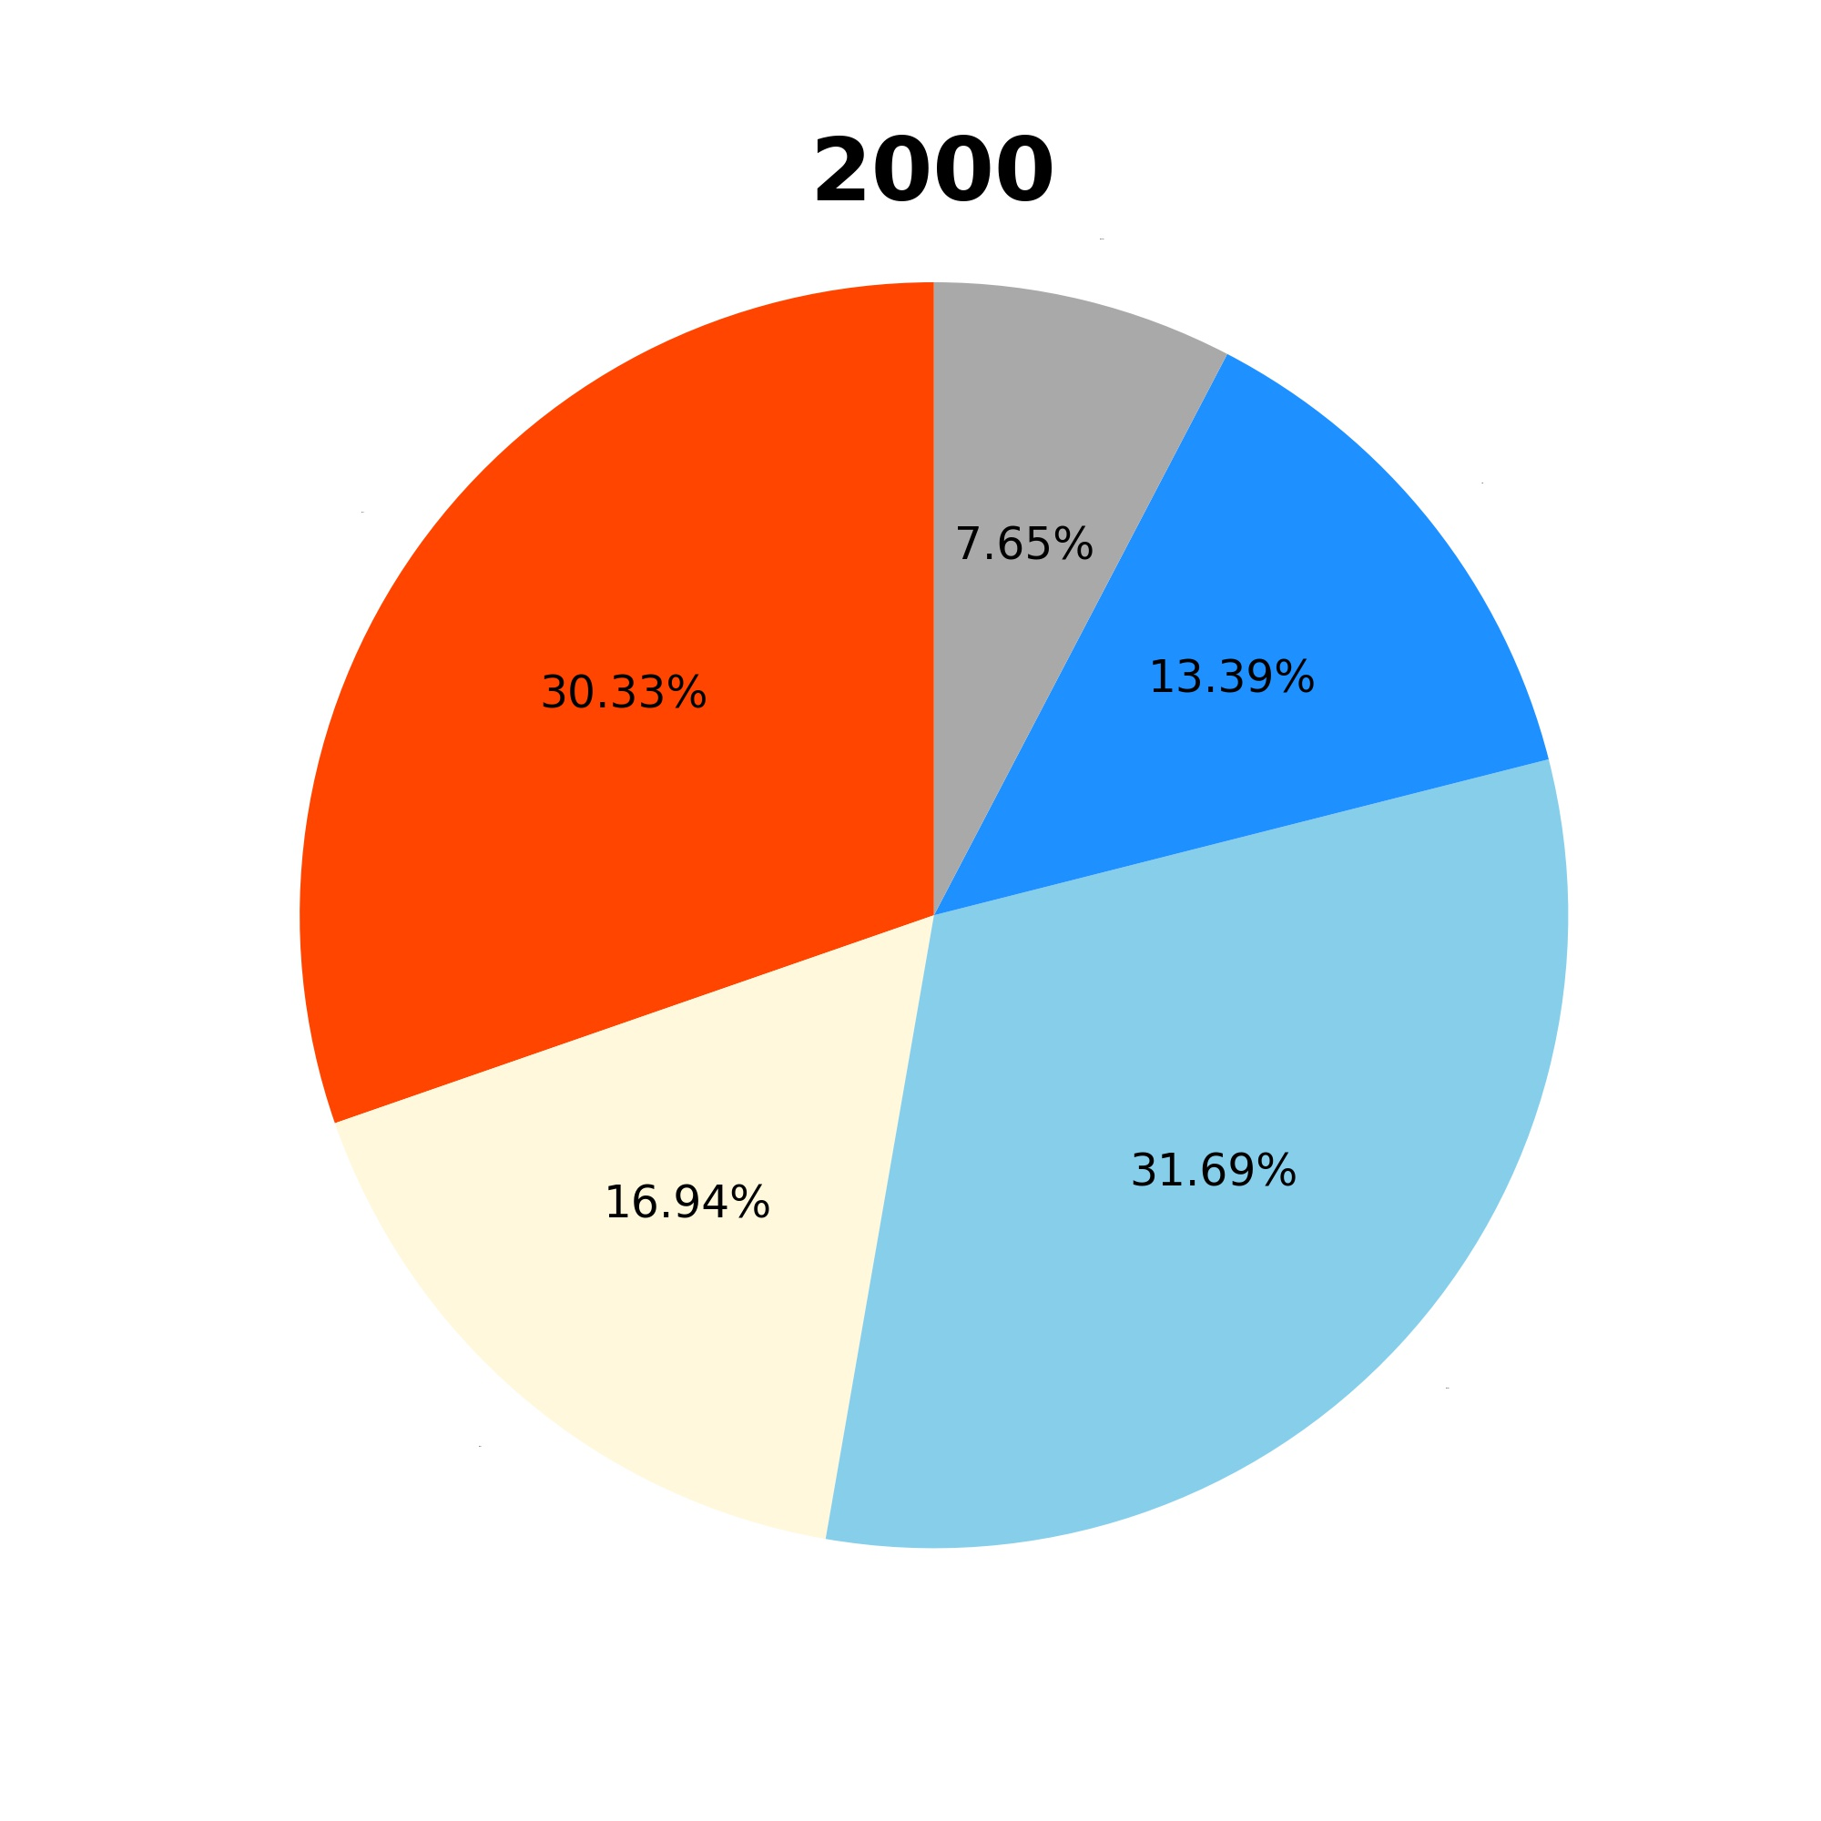
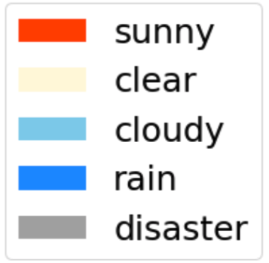
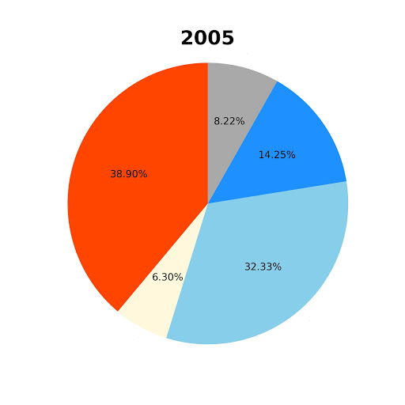
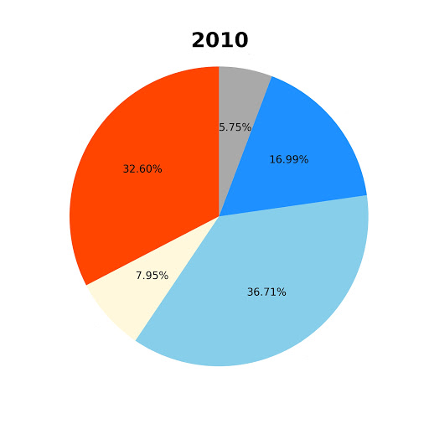
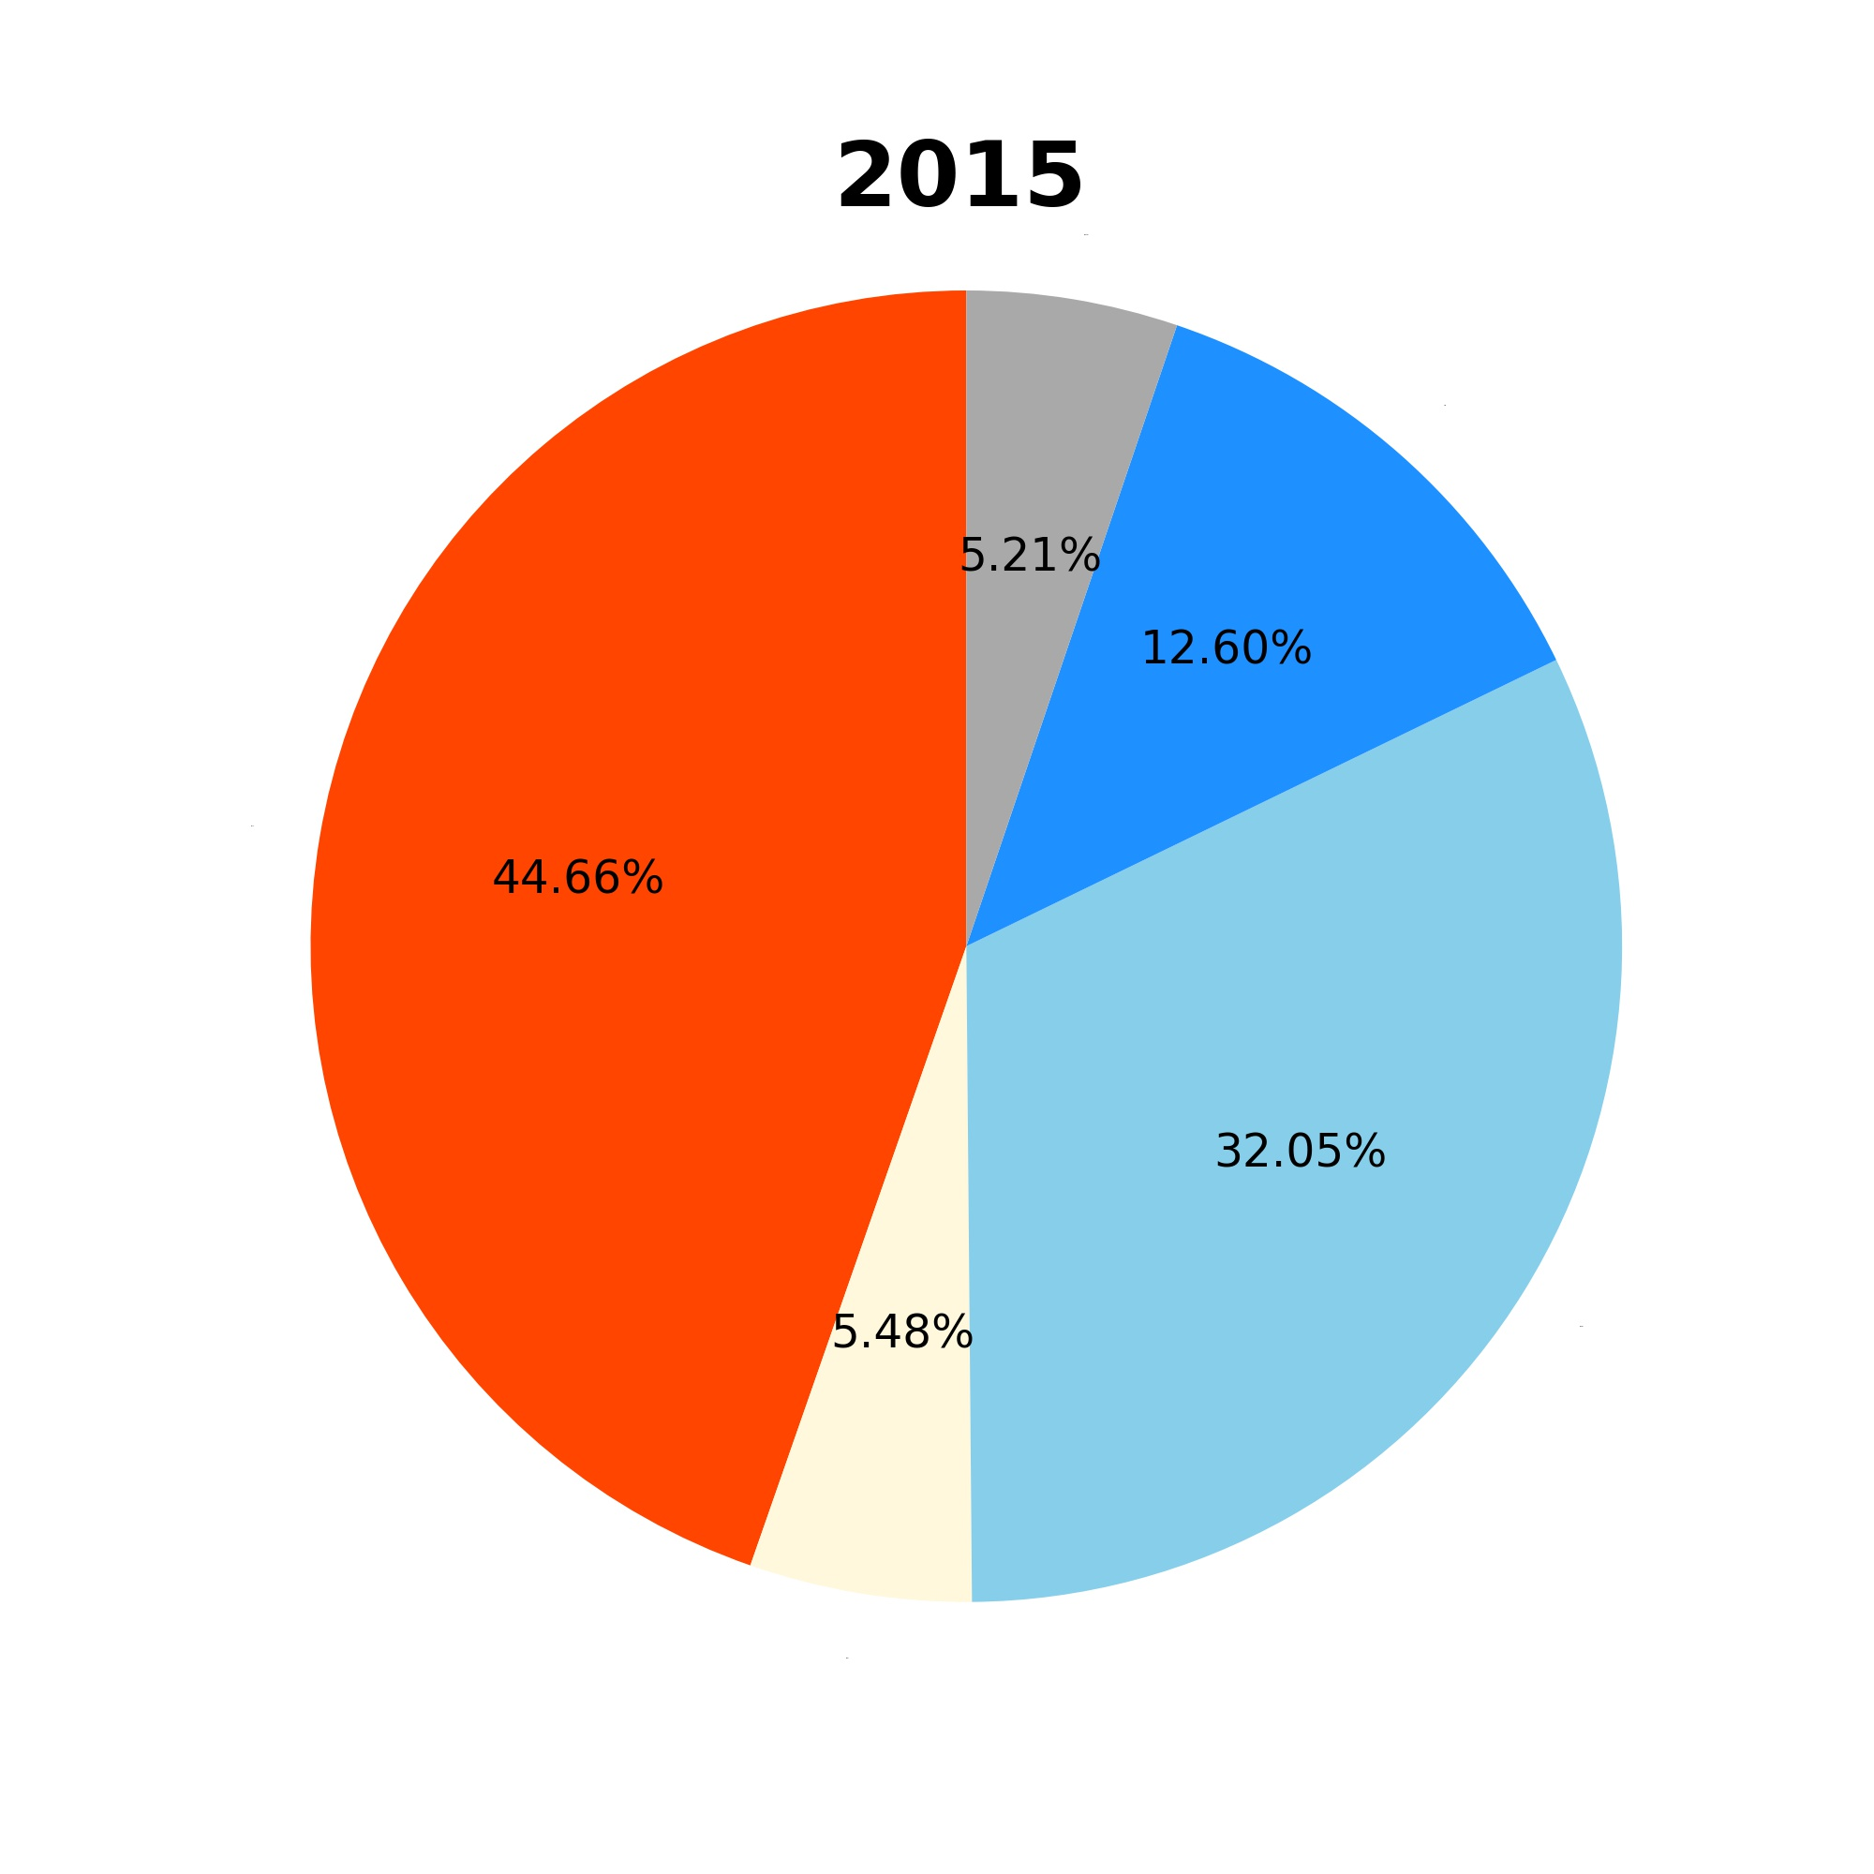
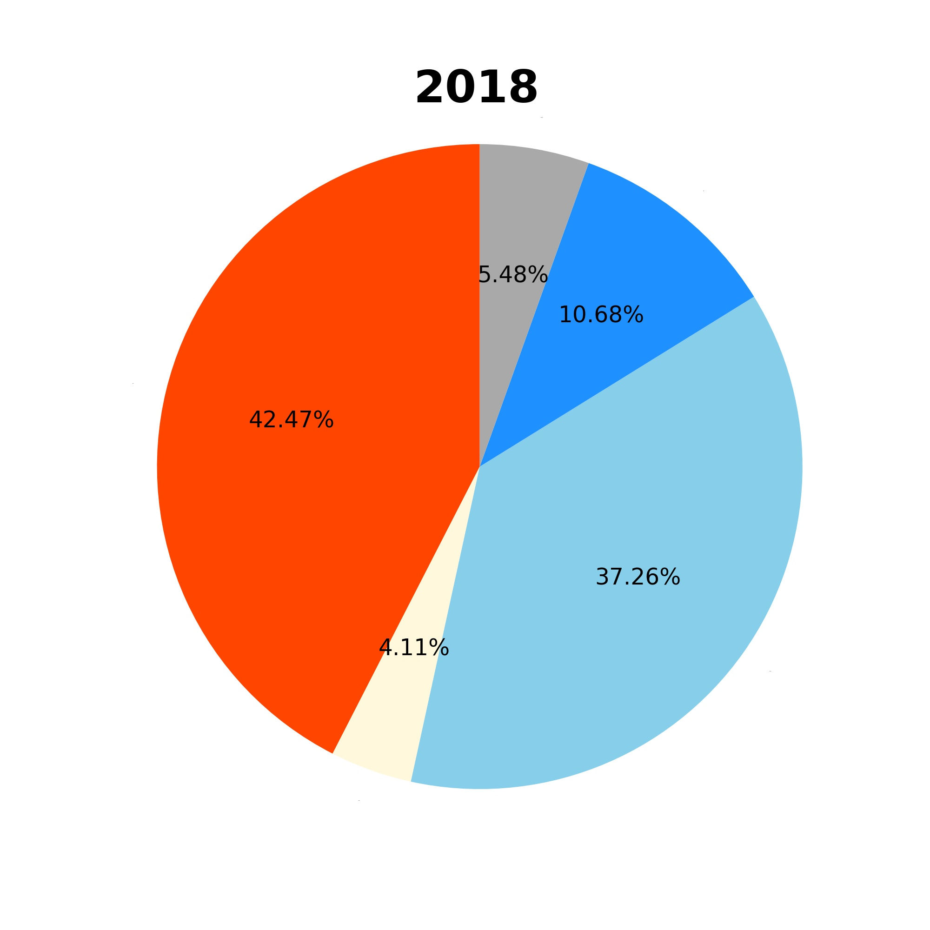
Weather of San Diego (1990 - 2018)
Notes:
The disaster weather condition includes hazy and stormy weather conditions.
For approximately half of the days, San Diego has either sunny or clear sky.
San Diego’s climate has been consistent in terms of rainy days since 2000’s. The city, on an average experiences less than 25% rainy/stormy days per year.

Slide 22

Weather of San Diego (1990 - 2018)
The proportion of rainy days in San Diego is basically the same.
San Diego experienced severe disaster weather around 1995, but it has improved through the years.
Notes:
The disaster weather condition includes hazy and stormy weather conditions.
For approximately half of the days, San Diego has either sunny or clear sky.

Slide 23
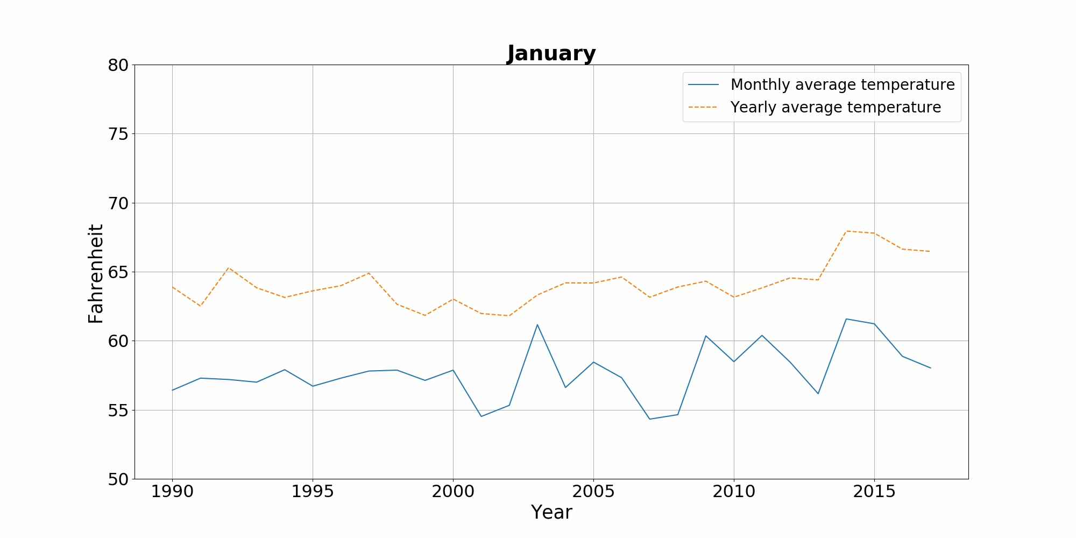
Average Temperature of San Diego (1990 - 2018)
Notes:
The average temperature of san diego has slightly risen in the last decade.

Slide 24
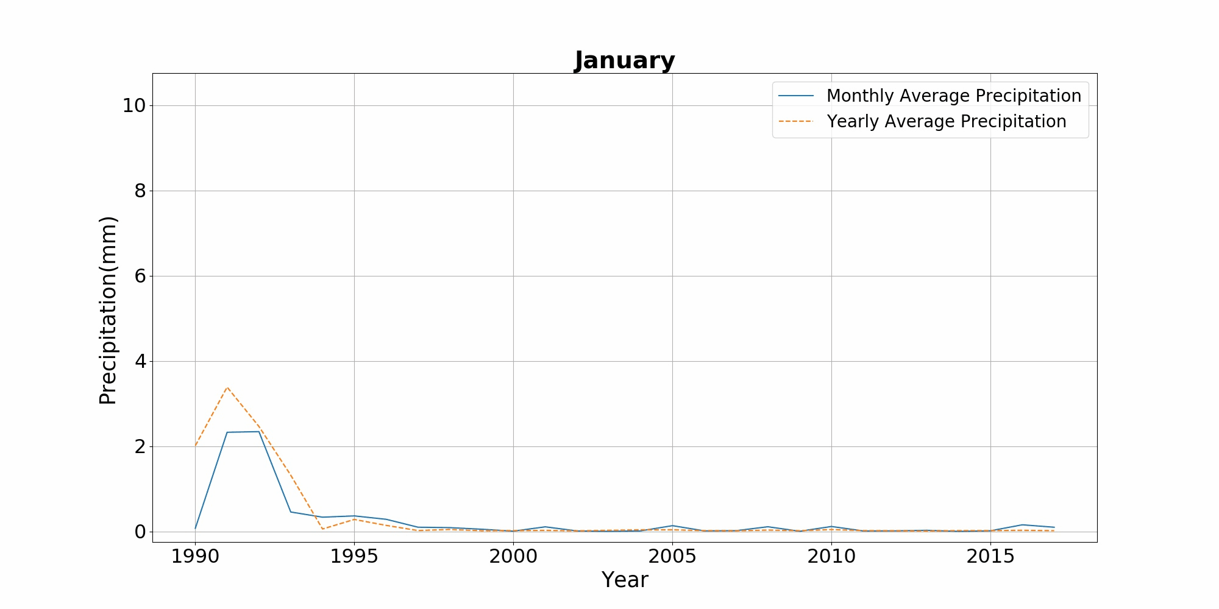
Average Precipitation in San Diego (1990 - 2018)
Notes:
The overall precipitation in San Diego is relatively small, mostly in the autumn and winter seasons.

Slide 25
Summary
The average temperature per month in San Diego has fluctuated over the years but has shown a slight upward trend overall.
The overall precipitation in San Diego is relatively small, mostly in the autumn and winter seasons.
Overall, San Diego is a city with moderate temperatures, mostly sunny days and less precipitation. But still receiving the impact of global climate change, the temperature has risen.

Slide 26
Evaluations and Applications
/05

Slide 27
Evaluations and Applications
Demo
Since we don’t have an access to the comprehensive weather data for a longer duration of time, we are not able to make any comment on climate change in general.
After evaluation, this project can be used to get an overall picture of the weather conditions of a city, just by plugging in the city code.
Notes:
Show code?

Slide 28
Future Works
Comprehensive Evaluation: Increase the number of cities inspected to find the more general trends and conclusions
Bigger Dataset: Add the data of years before 1990 to study real - climate change
Data Compensation: Optimize the way in which missing data is compensated
Outlier handling: Add processing mechanism for exception data

Slide 29
Thanks!

Slide 30
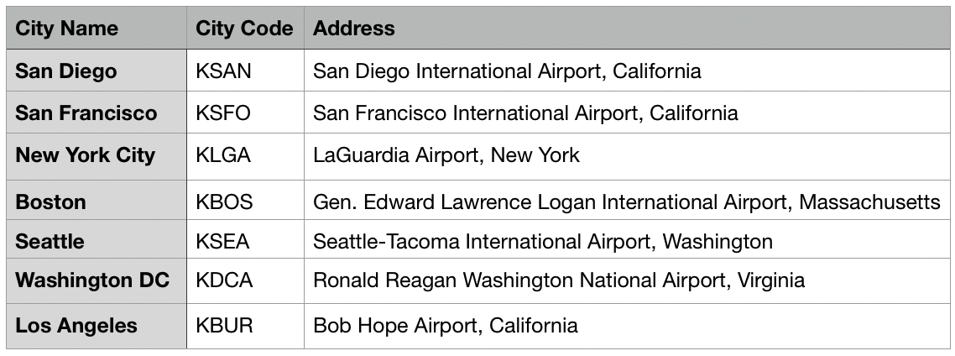
Appendix - City Code Reference
back

